Slide 1

Exploratory analysis of Big Data and Cloud EDABDC
Preparing and processing data with Azure Data Factory

Slide 2
Building an ETL Data Pipeline Using Azure Data Factory
ETL is the process that extracts the data from various data sources, transforms the collected data, and loads that data into a common data repository.
It helps organizations across the globe in planning marketing strategies and making critical business decisions.
Azure Data Factory (ADF) is a cloud-based ETL and data integration service provided by Azure.
We can build complex ETL processes and scheduled event-driven workflows using Azure Data Factory.

Slide 3
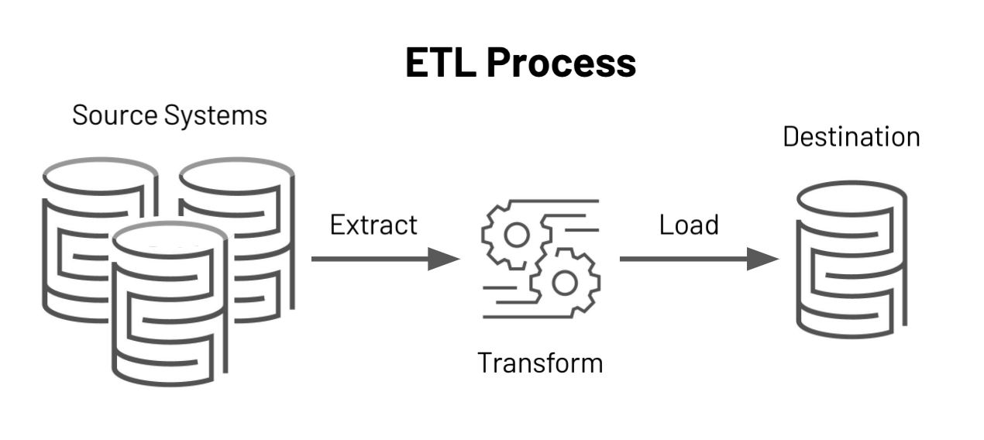
What is ETL
ETL (Extract, Transform, Load) is a fundamental data integration process used to combine, cleanse, and organize data from multiple sources into a consistent format. Let's break down each step:
Extract: Data is extracted from various source systems, such as databases, APIs, files, or legacy systems. Extracted data can be raw, unprocessed, and diverse in structure.
Transform: During the transform phase:
Data is cleaned, enriched, and standardized.
Complex operations like aggregation, filtering, and joining are performed.
Business rules are applied to ensure data quality and consistency.
Transformations prepare the data for analysis and reporting.
Load: The transformed data is loaded into a target system, such as a data warehouse, data lake, or database. Loading involves writing data into tables or storage structures for efficient querying.
ETL pipelines serve as the foundation for data analytics, machine learning, and business intelligence.

Slide 4
ETL vs ELT
Feature | ETL (Extract, Transform, Load) | ELT (Extract, Load, Transform)
Definition | Data is extracted, transformed on an ETL server, and then loaded into the data warehouse. | Data is extracted and loaded into the data warehouse first, and then transformed within the data warehouse.
Data Flow | Source → ETL Server (Transform) → Target (Load) | Source → Target (Load) → Target (Transform)
Transformation Location | External ETL server or processing tool | Within the data warehouse
Use Cases | Suitable for complex transformations before loading data | Suitable for large datasets and real-time data processing

Slide 5
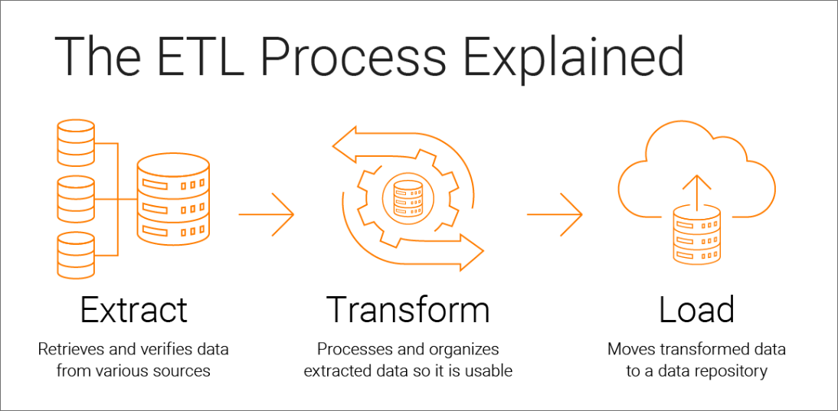

Slide 6
What is ADF?
Azure Data Factory (ADF) is a cloud-based ETL and data integration service provided by Azure.
We can build complex ETL processes and scheduled event-driven workflows using Azure Data Factory.
It is Code-free data transformation tool.

Slide 7
Example
For example, imagine an e-commerce company that collects petabytes of product purchase logs that are produced by selling products in the cloud. The company wants to analyze these logs to gain insights into customer preferences, customer retention, active customer base, etc.
The logs are stored inside a container in Azure Blob Storage. To analyze these logs, the company needs to use reference data such as marketing campaign information, customer location & purchase details which are stored in the Azure SQL database. The company wants to extract and combine data from both sources to gain useful insights. In such scenarios, it is best to use Azure Data Factory for ETL purposes. Additionally, the company can publish the transformed data to data stores such as Azure Synapse Analytics, so that the business intelligence (BI) applications such as Power BI can consume it for storytelling and dashboarding.

Slide 8
What are the activities and types of activities in ADF?
1. Data movement activities: Data movement activities are used to move data from one data source to another. For example, a Copy activity is used to copy the data from a source location to a destination.
2. Data transformation activities: Data transformation activities are used to perform data transformation in ADF.

Slide 9
Some important data transformation activities
Data Flow: Data flow activity is used to perform data transformation via mapping data flows.
Stored Procedure: Stored Procedure activity invokes a SQL Server Stored Procedure in a pipeline.
Azure Functions: This activity helps to run Azure Functions in a data pipeline. The azure function is a serverless compute service that helps users to run the event-triggered code.
Databricks Notebook: This activity helps to run the Databricks notebook in your Azure Databricks workspace from a pipeline.

Slide 10
Building ETL Data Pipeline

Slide 11
Other ETL Examples
Transformation Type | Examples
Data Cleaning | Removing duplicates, handling missing values, correcting errors
Data Aggregation | Summarizing data (totals, averages), grouping data (e.g., sales by region)
Data Integration | Combining data from multiple sources, joining tables using keys
Data Formatting | Standardizing formats (dates, phone numbers), parsing complex fields
Data Enrichment | Adding external data, calculating new fields (e.g., age from birthdate)
Data Filtering | Selecting specific records based on criteria, removing outliers
Data Sorting | Ordering data based on one or more fields (e.g., date, alphabetical order)
Data Masking | Anonymizing data to protect privacy (e.g., replacing names with IDs)
Data Normalization | Scaling data to a common scale (min-max scaling, z-score normalization), structuring data to a standard schema
Type Conversion | Converting data types (e.g., string to integer, date to timestamp)
Deduplication | Identifying and removing duplicate records
Currency Conversion | Converting monetary values from one currency to another based on exchange rates

Slide 12

Questions

